Slide 1


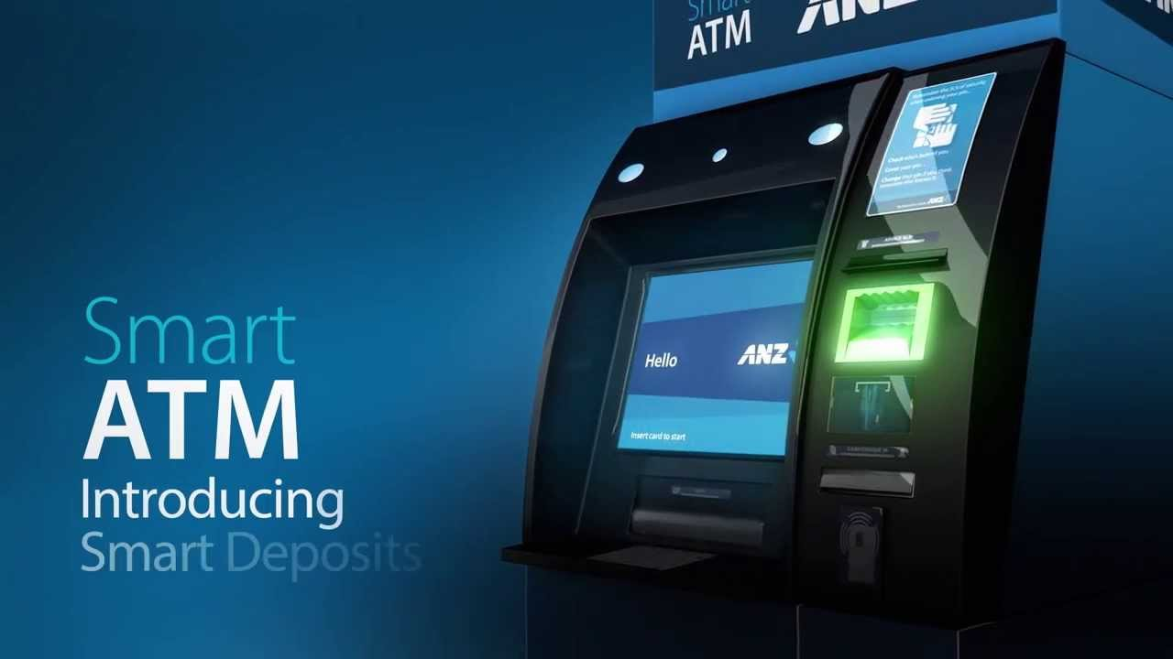


SMART ATM SURVEILLANCE SYSTEM
Presentation on,
SUBMITTED BY,
POOJA ANIL
LMC17MCA004
S6 MCA
LMCST

Slide 2


Presentation outline
Problem statement
Introduction to platforms
Proposed system
Evaluation
Conclusion
Introduction
Objective
Existing System

Slide 3


Problem statement
LACK OF PROPER PROTECTION FROM ATM PHYSICAL ATTACK.
LACK OF PROPER MAINTENANCE FOR ATM & NEARBY COMPONENTS.
SAVE OPERATORS FROM LOT OF HARDSHIP AND TIME.

Slide 4
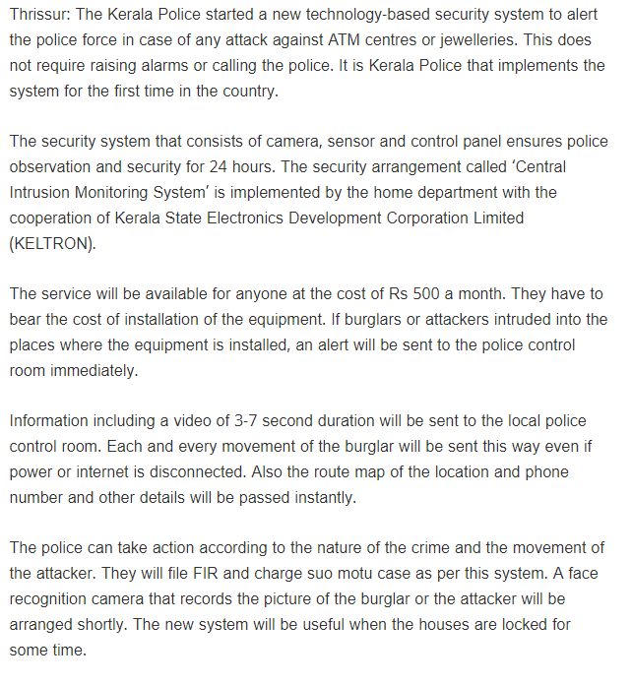
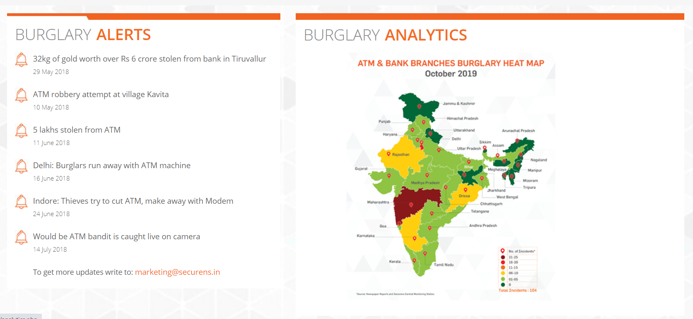

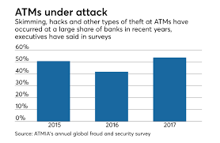
Literature survey

Slide 5
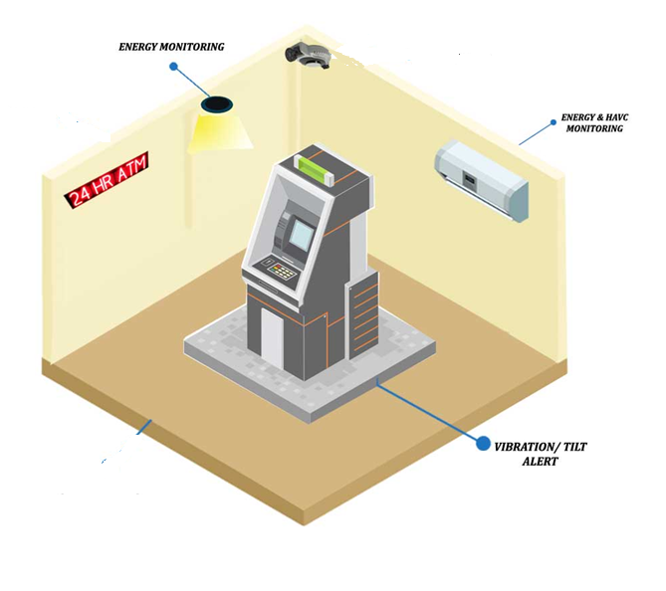
Introduction
This project proposes a smart IOT system based on embedded technology and incorporates various sensors to continuously monitor its surroundings for suspicious activities like physical attack.
This project also provide a maintenance system and controlling system for CCTV cameras, power supply, ATM machine, and AC.
The purpose of the system is to design a smart and centralized monitoring and control system using IOT technologies

Slide 6

Functionality
01
ATM PROTECTION
PROTECT ATM FROM PHYSICAL ATTACK
02
MOINTERING AND MAINTANCE SYSTEM
MOINTERING OF
AC
CCTV
03
POWER FAILURE DETECTION
CHECKING THE DETECTION OF POWER INSIDE THE ATM

Slide 7

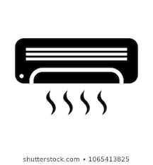


objectives
The prime objective of “ SMART ATM” is to develop a centralized controlling &mointering system for ATM and nearby components.
Also aim to make system that would be prepared for highly secured one. For enhancing the security of bank this framework is maintained by central processing unit.
In the central processing unit all the actions were monitored by the executives and information will be passed to the bank managers and local police stations through NODE MCU .After that if the theft was confirmed by the executives by checking the values of several sensor inputs using ThingSpeak & Blynk,then executives take corresponding action.
So that we can catch thief very easily and also we can keep the bank secure with the help of latest IOT technology

Slide 8
EXISTING SYSTEM
Video recorders record the output of each camera. After an incident, the video footage can be used as evidence. One obvious disadvantage of this approach is that operators are not able to prevent incidents or limit their damage.
Another disadvantage is that it takes a significant amount of time to search for the right video images, especially when the suspect arrives at the scene hours before the incident and a large amount of cameras are involved.
Moreover there is no continuous system for proper maintainance of ATM system components.
Currently to provide protection to the ATM and to the customers using it, there are CCTV security cameras and emergency sirens.
DRAWBACK OF EXISTING SYSTEM
Operators often work in a room with lots of monitors.Their task is to watch constantly the monitors. If incidents happen, they warn the security or police.
Some monitors show the video stream of a single camera and some show multiple streams on a single monitor simultaneously or sequentially.However, in some areas the monitors are not watched constantly.
.

Slide 9

Proposed system
The proposed system employs proactive measures to counteract the burglary attempt, here the sensors of the system act as first line of defence and detects the break-in and take the protective actions thereby successfully thwarting the attack. The proactive measures that are employed in the system are the siren, notification to officials using Blynk. Once any of the sensors are triggered the siren and the message will send to the authority and cause him to abandon the plot. Continues mointering is done through an IOT platform ThingSpeak.In the proposed system we utilize this platform for mointering, analysis, visual representation, collecting of data and has many other features which help our proposed system more accurate in real time mointering. By stopping the attack, the ATM is prevented from bearing any more harm caused due to the attack

Slide 10
Snapshot
MODULES
SOFTWARE MODULE.
HARDWARE MODULE
TECHNOLOGY USED
IOT-INTERNET OF THINGS
EMBEDDED TECHNOLOGY
FRONT AND BACK END
FRONT END: THINGSPEAK,ARDUNIO IDE
BACK END :THINGSPEAK CLOUD

Slide 11
PLATFORM USED
THINGSPEAK
BLYNK
ARDUNIO IDE
HARDWARE REQURIMENTS
NODE MCU,BUZZER
DHT11,VIBERATION,LDR SENSOR
SOFTWARE REQURIMENTS
THINGSPEAK,ARDUNIO IDE
BLYNK

Slide 12

TECHNOLOGY PLATFORM OVERVIEW
IOT The Internet of things (IoT) is a system of interrelated computing devices, mechanical and digital machines provided with unique identifiers (UIDs) and the ability to transfer data over a network without requiring human-to-human or human-to-computer interaction.
An IoT system consists of sensors/devices which “talk” to the cloud through some kind of connectivity. Once the data gets to the cloud, software processes it and then might decide to perform an action, such as sending an alert or automatically adjusting the sensors/devices without the need for the user.

Slide 13



MODULES
SOFTWARE MODULE
HARDWARE MODULE.
THINGSPEAK
BLYNK
ARDUNIO IDE
NODE MCU
DHT11 SENSOR
VIBERATION SENSOR
LDR SENSOR
BUZZER

Slide 14
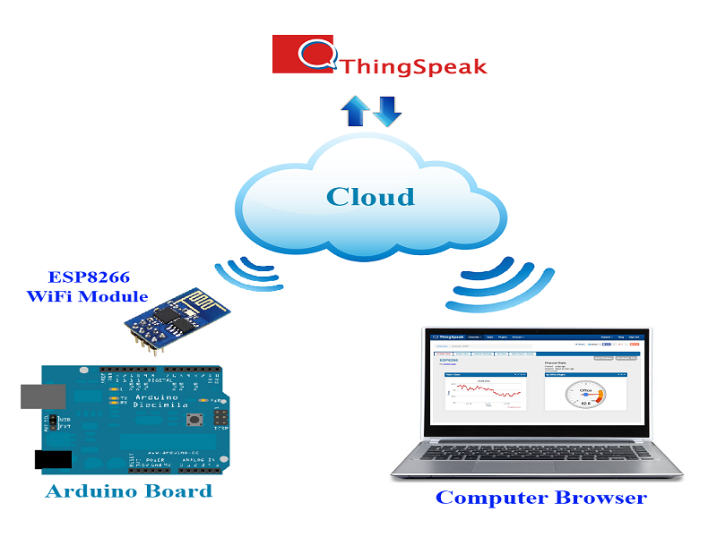
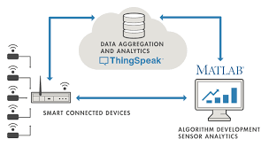
Software module
THINGSPEAK
It is an IOT analytics platform service that allow to aggregate,visualize and analyze live data stream in the cloud.
It provide instant visualizations of data posted by devices to ThingSpeak with the ability to execute MATLAB code in ThingSpeak we can perform online analysis and processing of the data.
ThingSpeak is an open-source Internet of Things (IoT) application and API to store and retrieve data from things using the HTTP and MQTT protocol over the Internet or via a Local Area Network.
ThingSpeak enables the creation of sensor logging applications, location tracking applications, and a social network of things with status updates..

Slide 15
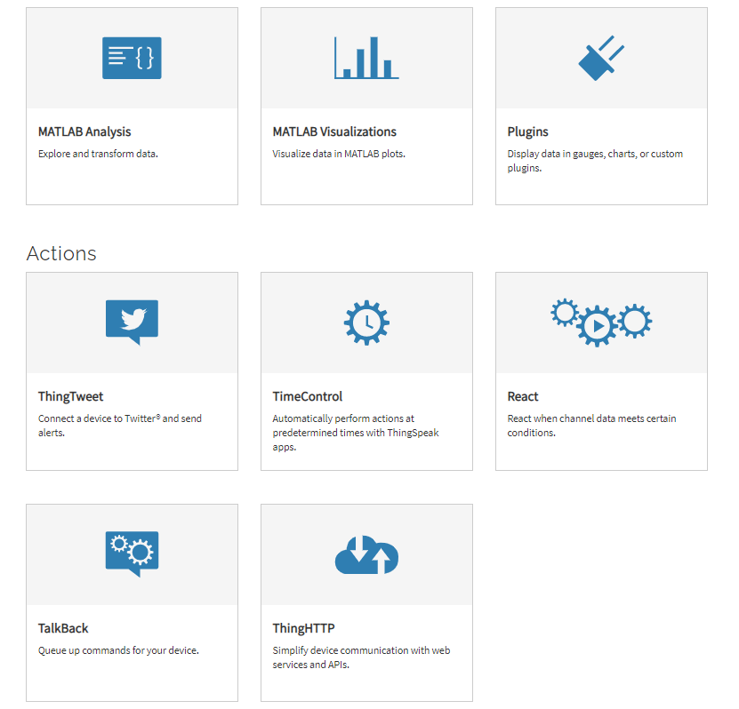
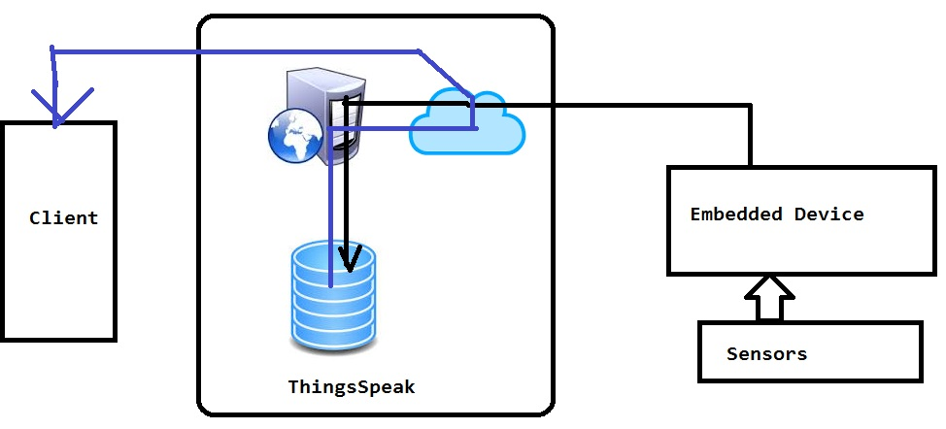
WHY THINGSPEAK ?

Slide 16
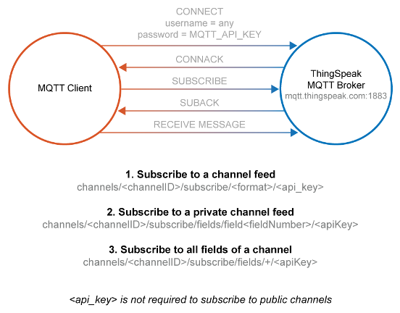
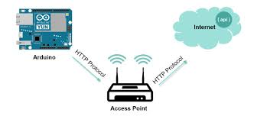
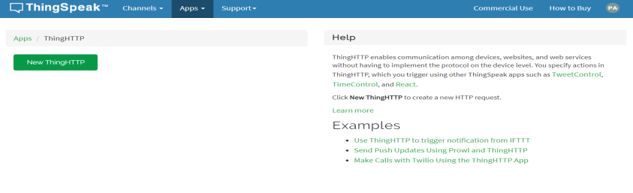
PROTOCOLS
HTTP
MQTT

Slide 17
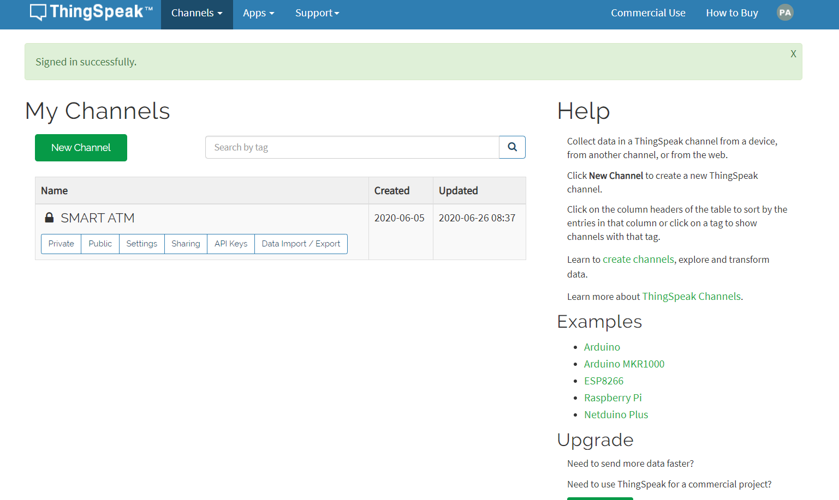
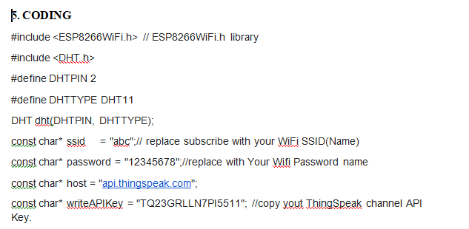
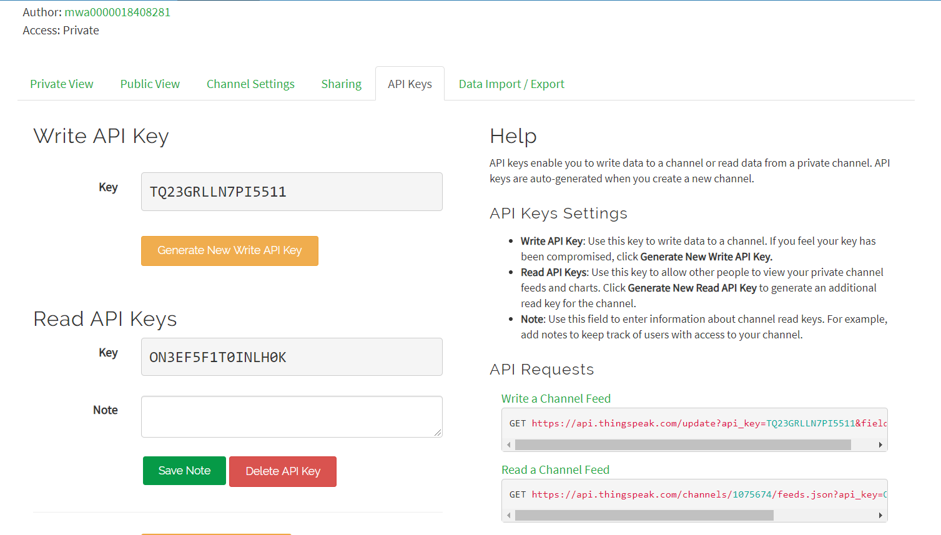

Slide 18
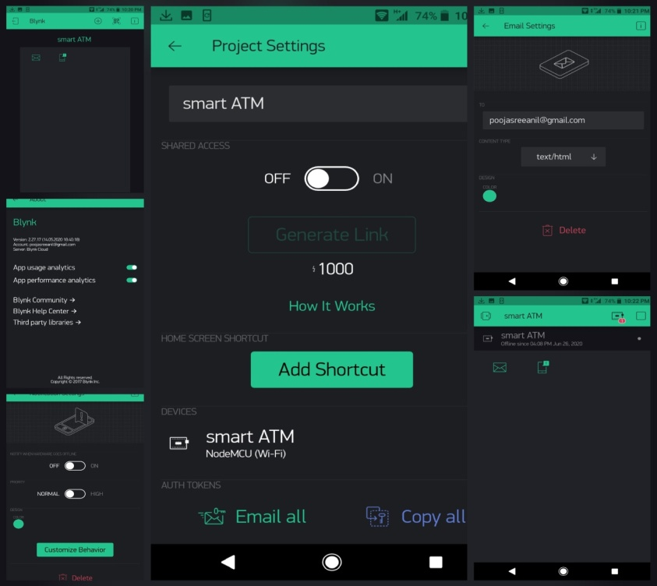
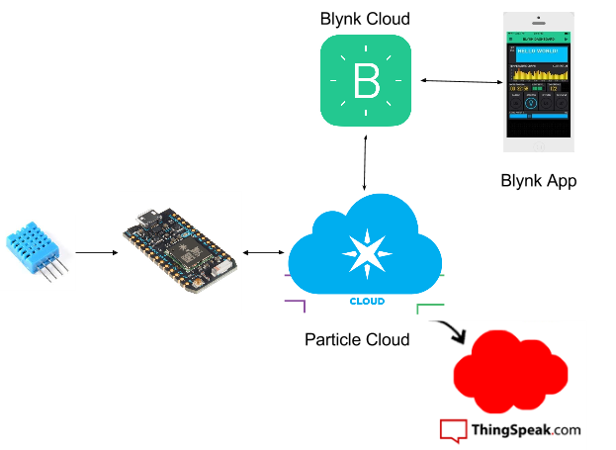
BLYNK
BLYNK ARCHITECTURE
The Blynk platform includes the following components:
Blynk app builder: Allows to you build apps for your projects using various widgets. It is available for Android and iOS platforms.
Blynk server: Responsible for all the communications between your mobile device that's running the Blynk app and the hardware.
Blynk libraries: Enables communication with the server and processes all the incoming and outcoming commands from your Blynk app and the hardware
Blynk is a new platform that allows you to quickly build interfaces for controlling and monitoring hardware projects from iOS andAndroid device..

Slide 19
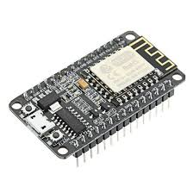
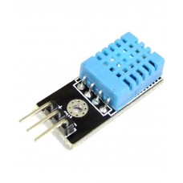
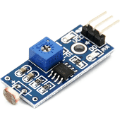
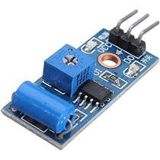
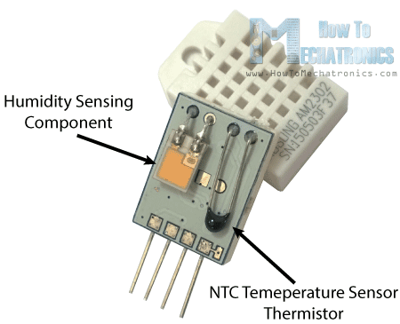
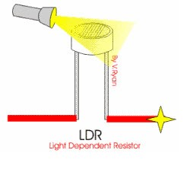
HARDWARE MODULE
TEMPERATURE & HUMIDITY SENSOR(DHT11)
LDR
.
MICROCONTROLLER
NODE MCU
VIBERATION SENSOR
NodeMCU is a low-cost open source IoT platform. It initially included firmware which runs on the ESP8266 Wi-Fi SoC from Espressif Systems, and hardware which was based on the ESP-12 module.
WORKING PRINCIPLE.
When there is change in capactive there is a change in humidity.IC measure the amount of change.
LIGHT DEPENDENT REGISTER.
WORKING PRINCIPLE
When light intensity increases,Resistance decreases.
A vibration sensor, also known as a piezoelectric sensor, has many types that are used to measure the acceleration, pressure, vibrational changes of a device or system.

Slide 20
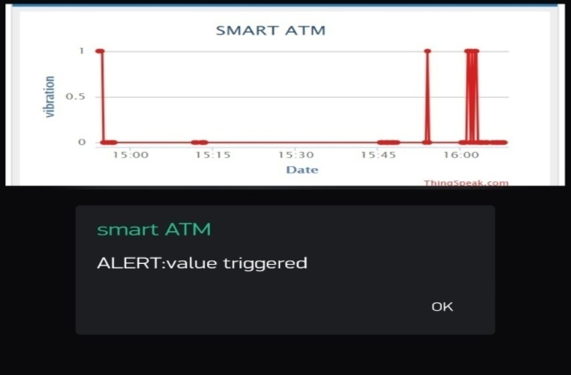
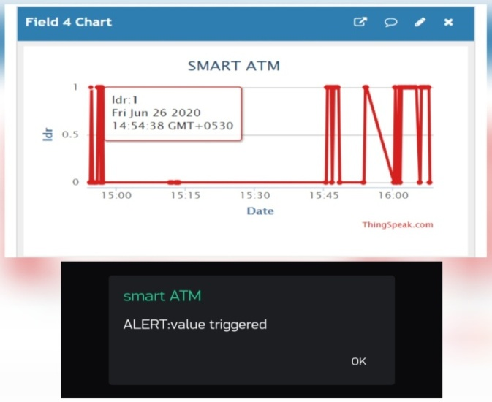
OUTPUT DESIGN
LDR SENSOR
.
VIBERATION SENSOR

Slide 21
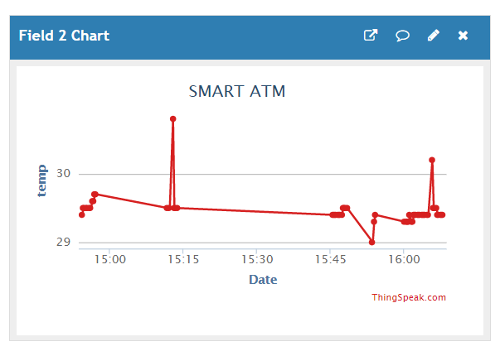
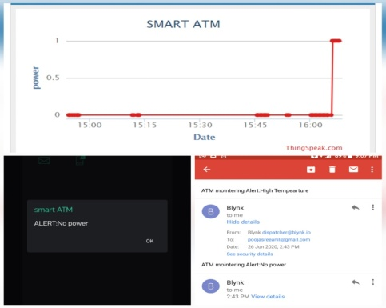
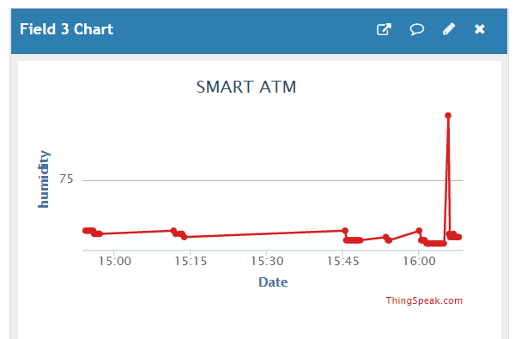
ii TEMPERATURE AND HUMIDITY SENSOR
iv POWER SUPPLY

Slide 22
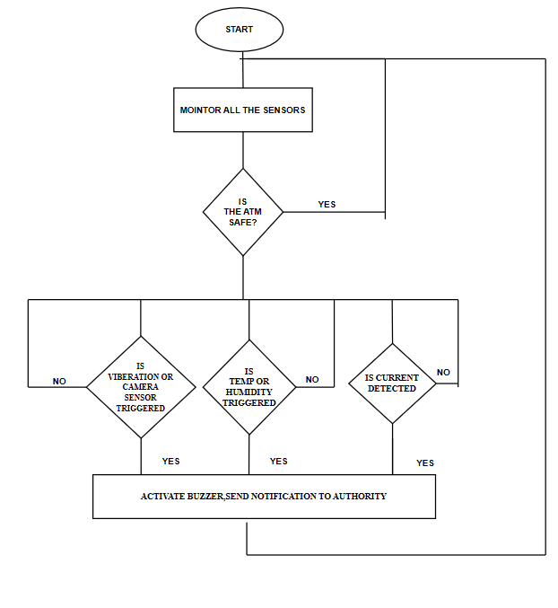
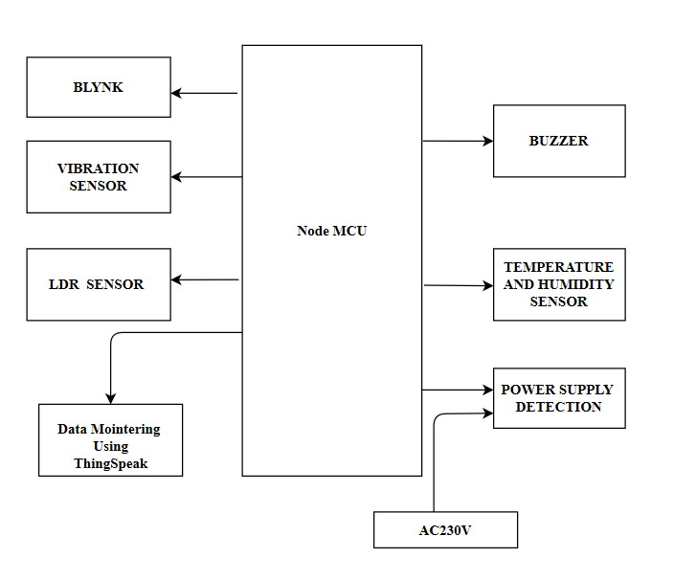
METHODOLOGY
FLOW CHART
BLOCK DIAGRAM

Slide 23

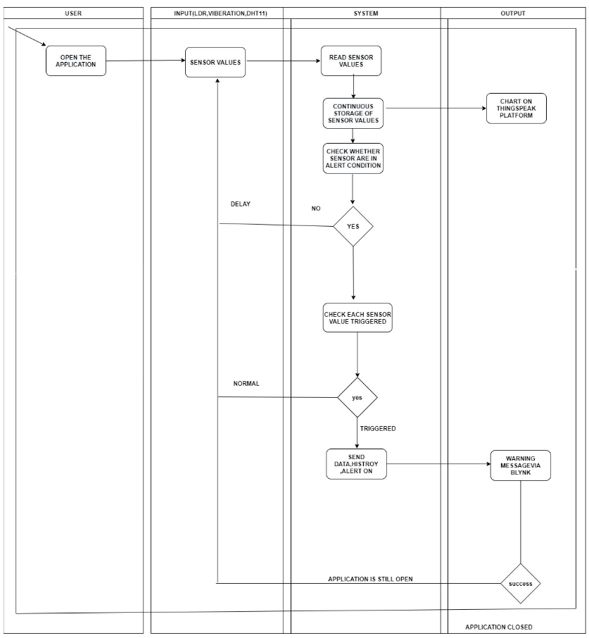
ACTIVITY DIAGRAM

Slide 24
working
FOR CCTV AND ATM PROTECTION
When an attacker enter the ATM ,if he try to hide the CCTV visual then LDR used here is for CCTV Mointering.
when he hide the CCTV camera density of light decreases and resistance increases.with this principle we implement the technique to mointer CCTV Camera is working or not.
If attacker attack the ATM, the ,value of the viberation sensor inside the ATM start to triggered.When value triggered isystem dentified it as an attack and take corresponding action.
MOINTERING AC AND POWER
DHT11 which is a temperature and humidity sensor which is used to measure amount of humidity and temperature inside the ATM .
If temperature and humidity value increases than the specified limit it means the AC is not working properly and automatically send message via blynk.
To check power supply,We can check whether current is present in the circuit or not using ThingSpeak.

Slide 25




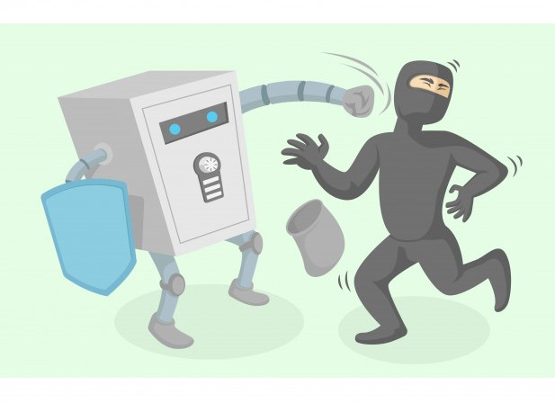
features
Continuous monitoring and maintance of the sensors in the system so that any burglary attempt is detected
Mointering of AC using Temperature and humidity sensor values.
Warning: The controller then sends an blynk alert and call alert to officials informing the break in happening.
Graphical representation of sensor values, timeline, history can be viewed through ThingSpeak graphics chart.
.

Slide 26

EXISTING SYSTEM V/s PROPOSED SYSTEM
CONTINUOUS MOINTERING OF CCTV VISUALS
CONTINUOUS MOINTERING OF SENSOR VALUE USING THINGSPEAK
NO REALTIME MOINTERING
REAL TIME MOINTERING USING THINGSPEAK AND BLYNK
TIME CONSUMING AND DIFFCULT TASK
AUTOMATIC NOTIFICATION TO RIGHT PEOPLE AT RIGHT TIME
NO MAINTANCE SYSTEM FOR NEARBY COMPONENTS
REAL TIME MAINTANCE SYSTEM FOR NEARBY COMPONENTS
.

Slide 27

EVALUATION
Results of our experiments show that the SMART ATM ,has mointering and notification android application called Blynk , real time mointering had been designed using ThingSpeak and the programs were uploading into NODE MCU. The project is successfully tested for all the commands and it also ensure security by implementing as a central processing unit. Once the attack is detected, the system send notification to bank and police. The ThingSpeak can mointer each and every second ,can display output in the form of graphs.
RESULTS
The proposed system incorporated with the following features.
Quick and appropriate action can be taken easily.
Human effort can be reduced.
Improved efficiency.
Security enhanced for ATM system.
Can control remotely from anywhere.
Give proper data history for all senser reading.
Provide maintance and controlling system

Slide 28

implementation
Installation of the hardware required for “SMART ATM SURVEILLANCE SYSTEM”, is required special hardware (Arduino UNO, Node MCU,LDR,DHT11,viberation sensor) which is to be installed for the working of both software and hardware. This can be worked on any system that support Ardunio IDE,ThingSpeak and a mobile device which support Blynk.Since the application is being developed with a server configured machine with a machine language. This case study is comparatively easy to implement. There are some technical risks where we can mointer Only five ATM through ThingSpeak at freeof cost. As a prerequisite you have to study about ThingSpeak,Basic of Ardunio, Ardunio coding,basic of electronics and working different sensors,other commonly used functionality will reduce our work and make the case study a beautiful one

Slide 29
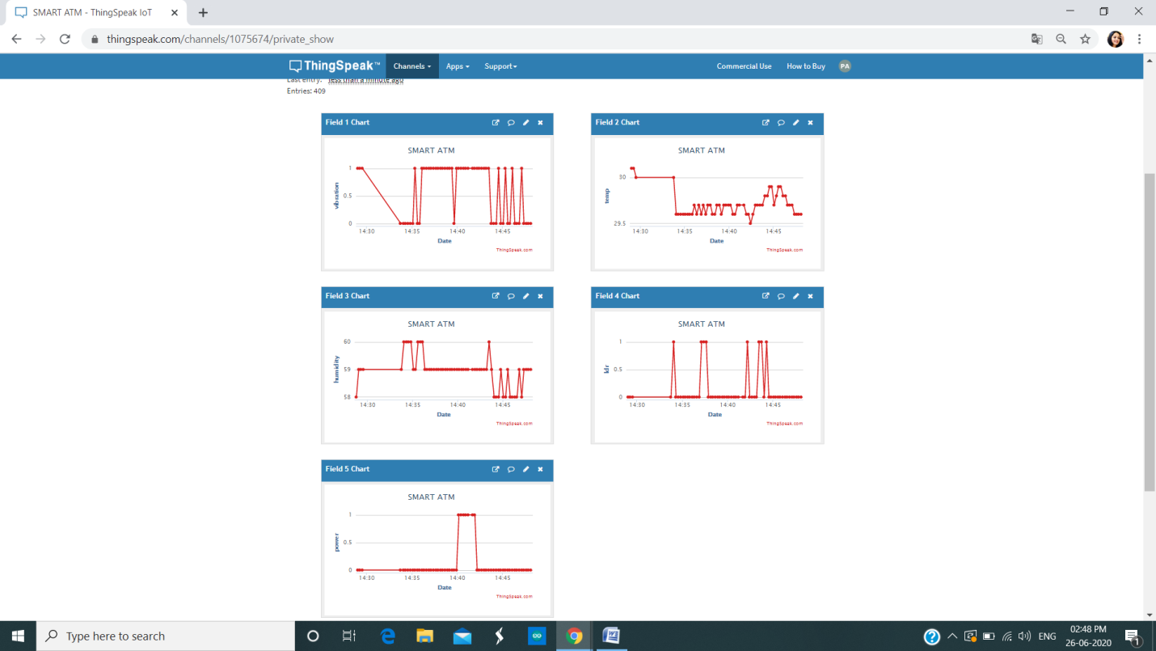


SCREENSHOTS

Slide 30

Future work
This project can be implemented in the form of small device which is easy to install inside the ATM.
This project can be integrated with additional features like detecting proper lightining inside the ATM
Can implementing an automatic arresting system.
Can provide an emergency button if a user trap inside the ATM.
Can use tilt sensor for second time verification whether an attack happen.
It can also integrated with a functionality of automatically checking user body temperature to take primary caution test against various spreading epidemic like Coronavirus disease (COVID-19)

Slide 31

CONCLUSION
The implementation of ATM surveillance by using smart sensors and NODE MCU took advantages making the system more secure. The security features were enhanced largely for protection of ATM’s when compared to previous systems. The whole system will be built on the technology of embedded system which makes the system more safe, reliable and easy to use. Therefore the proposed surveillance system here utilizes the latest technology like smart sensors and ThingSpeak which as a system has a very good endurance in the long run, which makes it ideal for protecting the ATM. Thus this system will be able to thwart physical attacks on the ATM and alerts necessary people to take action at any time and save people from lot of hardships involved in the ATM security.

Slide 32


